Slide 1
C++
USER DEFINED FUNCTIONS
AND
STRUCTURE.

Slide 2
FUNCTIONS
Void main()
{
Statement 1;
Statement 2;
Statement 3;
.
.
.
.
Statement n;
}
Void main()
{
Statement 1;
Statement 2; Sum1();
Statement 3;
Statement 4; Sum2();
Statement 5;
Statement 6;
}

Slide 3
Advantages
Support for modular programming
Reduction in program size.
Code duplication is avoided.
Code reusability is provided.
Functions can be called repetitively.
A set of functions can be used to form libraries.

Slide 4
Types
1.Built in functions :-
are part of compiler package.
Part of standard library made available by compiler.
Can be used in any program by including respective header file.
2. User defined functions:- Created by user or programmer.
Created as per requirement of the program.

Slide 5
User defined function
Void main()
{
Statement 1;
Statement 2; multiply();
Statement3;
;
; Sum();
return0;
}
multiply()
{
;
}

Slide 6
Parts of a function
main function
{
function prototype declaration
function call
-------;
}
function declaratory/definition
{
------;
return statement
}

Slide 7
Function prototype
A function prototype is a declaration of a function that tells the program about the type of value returned by the function, name of function, number and type of arguments.
Syntax: Return_type function_name (parameter list/argument);
int add(int,int);
void add(void);
int add(float,int);
4 parts
Variable declaration Data_type variable_name ; int x=5;
float marks; int price;
Return type
Function name
Argument list
Terminating semicolon

Slide 8

Function call
A function must be called by its name followed by argument list enclosed in semicolon.
Syntax: function_name (parameter list/argument);
add(x,y);
add(40,60);
add(void); or add();
Note: data type not to be mentioned.
Suppose
Now to this function
int add(int,int); add(x,y);
or add(40,60);
//prototype
//function call

Slide 9
Suppose
int add(int,float);
//prototype
add(x,y);
//function call
int float
Now suppose the function return some integer value, you can use a variable to store that value.
i.e z=add(x,y);

Slide 10
Parts of a function
main function
{
function prototype declaration function call
}
function declaratory/definition
{
return statement
}

Slide 11
Function definition
2 parts
Function header
Note: no semicolon in header
Syntax: function_type function_name(parameter list)
{
Local variable declaration; Function body statement; Return statement;
}
Example: int add(int,int);
Z=add(x,y);
Function body
//prototype
//function call
int add(int a,int b)
{
body statement; Return(a+b);
}j
//function definition

Slide 12
#include<iostream.h> using namespace std;
#include<iostream.h> using namespace std;
int main()
{
Print();
return 0;
}
void print()
{
cout<<“2 is even no.”<<endl;
}
Error message since print was not declared in the scope.
int main()
{
Print(); return 0;
}
void print()
{
cout<<“2 is even no.”<<endl;
}

Slide 13
Why prototyping?????
#include<iostream.h> using namespace std;
void print();
Return_type function_name (parameter list/argument);
int main()
{
print(); return 0;
}
function_name(parameter list/argument);
void print()
{
cout<<“2 is even no.”<<endl;
function_type
function_name(parameter list)
}

Slide 14
Parts of a function
main function
{
function prototype declaration
Return_type function_name(arguments); eg: int add(int);
function call
-------;
}
function_name(actual arguments); eg: add(a);
function declaratory/definition
{
------;
return statement
}
Return_type function_name(formal arguments) eg: int add(int X);

Slide 15
Function categories
Function with no return value and no argument. void add(void);
Function with arguments passed and no return value. void add(int,int);
Function with no arguments but returns a value. int add(void);
iv) Function with arguments and returns a value. int add(int,int);
iii)

Slide 16
I. Function with no return value and no argument
void main()
{
void disp(void); //prototype
disp(); return 0;
}
//caller function
No value returned from calle to caller function
No arguments passed
from caller to calle
void disp() //calle function
{
cout<<“--------”<<endl;
}

Slide 17
//program to print square of a number using functions. void main()
{
void sqr(void); sqr();
getch(); return 0;
}
void sqr()
{
int no;
cout<<“enter a no.”; cin>>no;
cout<<“square of”<<no<<“is”<<no*no;
}

Slide 18
ii. Function will not return any value but passes argument
#include<iostream.h> #include<conio.h> void add(int,int);
int main()
{
add(a,b);
int a,b;
cout<<“enter values of a and b”<<endl; cin>>a>>b;
add(a,b);
getch(); return 0;
}
void add(int x,int y)
{
int c; c=x+y;
cout<<“addition is”<<c;
}
a b
void add(int x,int y);

Slide 19
iii) Function with arguments and return value
main function
{
int sqr(int);
int a,ans;
cout<<“enter a number”; cin>>a;
ans=sqr(a);
cout<<“square of number is”<<ans; getch();
return 0;
}
//function prototype
//function call
int sqr(int X)
{
return(X*X);
}
//function declaratory/definition

Slide 20
iv) Function with no arguments but returns a value
int main()
{
int add(void); int z; z=add();
cout<<sum of 2 nos is”<<z;
getch(); return 0;
}
Function call add(x,y);
i.e z=add(x,y);
int add(void);
{
int a,b;
cout<<“enter 2 nos”; cin>>a>>b;
return(a+b);
}

Slide 21
Pointers
Special type of variables which hold the address of another variable
i.e no values or datas are stored but it points to another variable where data is stored.
int a=100;
1)a→ name
Pointer stores this memory location, no direct value is stored.
100
→ 2)value
3)address

Slide 22
a
100
Declaration:
Data_type
*variable_name;
int a=100; int *ptr;
ptr=&a; //referencing
address 1
Intialisation:
“Address of” operator
ptr
address 1
or
int a=100; int *ptr=&a;
address 2
Pointer initialisation and declaration

Slide 23
Note: a pointer can be used to point to another pointer also i.e it can store the address of another pointer.
a
int a=100; int *ptr=&a;
int **ptr1=&ptr;
100
cout<<a; //100 cout<<*ptr;//100 cout<< **ptr1; //100
address 1
ptr
address 1
address 2
Note: pointer 1 points to address of ptr.
ptr1
address 2
address 3

Slide 24
#include<iosream.h> #include<conio.h>
int main()
{
int a=100;
int *p1; int * *p2; p1=&a; p2=&p1;
cout<<“address of a”<<&a; cout<<“address of a”<<p1;
cout<<“value of a”<< *p1; cout<<“value of a”<< * *p2; cout<<p2;
cout<< *p2; getch();
}
Chain of pointers
a
p1 p2
100
address 1
address 2
address 1
address 2
address 3
//p1 points to address of a
// p2 points to address of p1

Slide 25
When a variable is declared as reference, it becomes an alternative name for an existing variable. A variable can be declared as reference by putting ‘&’ in the declaration.
Reference variable in C++
int a=100;
Now we will use a reference variable i.e two names
for same memory location.
a
100
int a=100;
int &ref=a; //initialization and declaration
Now in program we can use either “a” or an alternative name “ref”
C=a+b; //same output C=ref+b;
0012dcD2

Slide 26
Program using reference variable
#include<iostream.h> #include<conio.h> int main()
{
int a=100; int &ref=a;
cout<<“value of a is”<<a;
cout<<“value of ref is”<<ref;
cout<<address of a is”<<&a; cout<<address of a is”<<&ref; getch();
}
100
100
0012dcD2
0012dcD2
Both “a” and “ref” are used for same memory location as alternative name

Slide 27
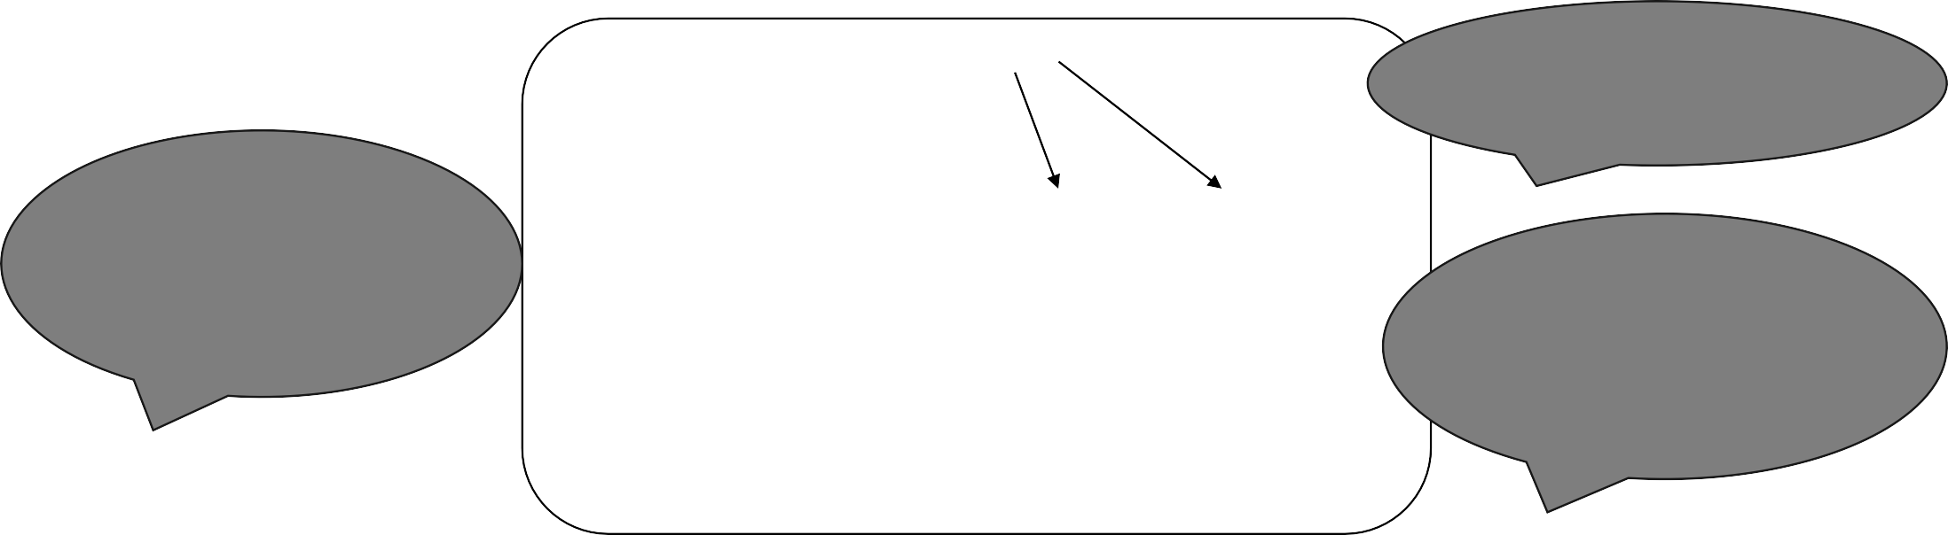
Call by value
A function can be invoked in two manners (i)call by value
(ii)call by reference
The call by value method copies the value of actual parameters into formal parameters i.e the function creates its own copy of arguments and uses them.
add(a,b);
Values of variables a and b are passed to X,Y
}
void add(int x,int y);
{
--------;
}
Call by value where the values of variable are passed to functions
Now if you change the value of X and Y, those changes are not seen in a and b

Slide 28
/* program to illustrate the concept of call by value */
#include<iostream.h> #include<conio.h> void add(int,int);
int main()
{
int a,b;
cout<<“enter values of a and b”<<endl; cin>>a>>b;
add(a,b);
getch(); return 0;
}
void add(int x,int y)
{
int c; c=x+y;
cout<<“addition is”<<c;

Slide 29
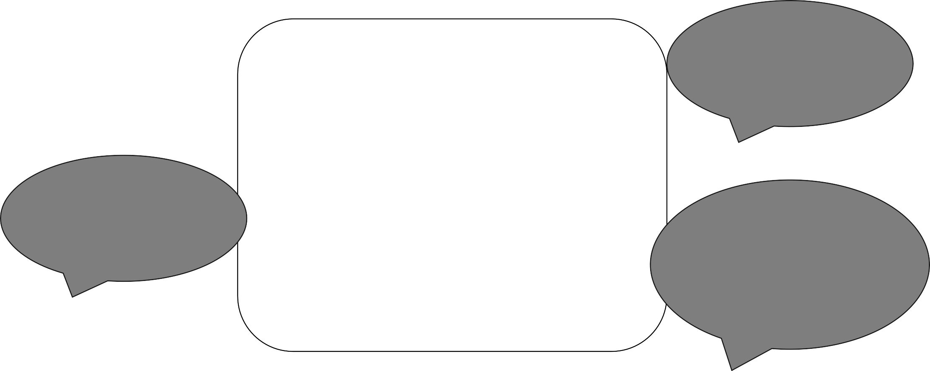
Call by reference
In call by reference method in place of calling a value to the function being called , a reference to the original variable is passed .i.e the same variable value can be accessed by any of the two names.
In function call We write reference variable for formal arguments
add(a,b);
}
void add(int &x,int &y);
{
--------;
}
No need for return statement
&X,&Y will be the reference variable for a and b. if we change X and Y, Value of a and b are changed accordingly

Slide 30
swap(a,b); cout<<“after swaping”; cout<<“A”<<a; cout<<“B”<<b; getch();
Program to illustrate call by reference
#include<iostream.h> #include<conio.h> void swap(int &,int &); int main()
{
int a,b;
}
void swap(int &X,&Y)
{
int temp; temp=X;
X=Y;
Y=X;
}
cout<<“enter the values of a and b”; cin>>a>>b;
cout<<“before swaping”; cout<<“A”<<a; cout<<“B”<<b;

Slide 31
Struct Data Type in C++
What Are Structures?
A structure is a data type that is an aggregate; that is, it contains other data types, which are grouped together into a single user-defined type.
It is like an array, but the array is homogenous and the structure is heterogeneous
Structures are used when it makes sense to associate two or more data variables.
Structures are made up of member variables.

Slide 32
Declaring a Struct Type and Struct Variable
Synatx:
struct struct_name
{ <type> field1-name;
<type> field2-name;
…
<type> fieldn-name;
} ;
Declaring a structure introduces a new type of variable into your program, struct variables.
Variables of this new type can be defined just like int, char, or float variables are defined.

Slide 33
Declaring a Struct Type and Struct Variable
An example of a structure is a payroll record, where the number of hours worked and the pay rate are combined in a structure, as shown below:
struct PAYROLL_REC
{ double hours;
double rate;
};
The declaration
PAYROLL_REC pay1;
declares pay1 variable to be of type PAYROLL_REC
It Allocates storage space for two variables: hours, rate.

Slide 34
Accessing Members of a Struct
Accessing struct is by using the member access operator, a period ( a dot) placed between a struct variable and a member name for that struct type.
E.g., pay1. hours = 30.0
pay1.rate = 2.5

Slide 35
Examples on Struct
Example1: Using a structure to calculate a weekly salary.
#include <iostream.h>
struct PAYROLL_REC
{ double hours;
double rate;
};
void main()
{ PAYROLL_REC pay1;
pay1.hours = 40.0;
pay1.rate = 3.75;
cout << "This week's payroll information:" << endl;
cout << "Hours worked : " << pay1.hours << endl;
cout << "Rate :$" << pay1.rate << endl;
double salary = pay1.rate * pay1.hours;
cout << "Salary :$" << salary << endl;
}

Slide 36
Examples on Struct
Example 2: Using struct and array to store student’s information.
#include <iostram.h>
#include <cstring>
struct ExamStats
{ char name [20]; int scores[4];
float average; char grade;
};
void printStats(ExamStats stuExams )
{ cout<<“Exam scores for “<<
stuExams.name<<“: “ <<
stuExams.scores[0]<<“ “<<
stuExams.scores[1]<<“ “<<
stuExams.scores[2]<<endl;
cout <<“Average score: “<<stuExams.average<<endl;
cout<<“Letter garde: “<<stuExams.grade<<endl;
}
void main( )
{ ExamStats student;
cin.getline(student.name, 20, ‘\n’);
for (int i = 0; i<3; i++)
cin >>student.scores [i];
cin >> student.average;
cin >> student.grade;
printStats (student);
}

